Slide 1
Lab 11

Slide 2
Step 1
Create a java project in eclipse for Lab 11, and import the three java files into the Lab 11 folder (HelloWorldSwing, HelloWorldMore and Lab11)

Slide 3

Step 2
Look at HelloWorldSwing look at the syntax for Jframe and Jlabel you will need to use this syntax again
Run the code, you should get a pop up like this (for me it appeared on the top left)

Slide 4

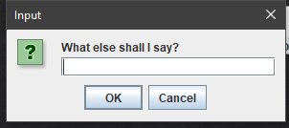

Step 3
Look at HelloWorldMore, notice that the line frame.setVisibile(true) appears twice
When you run the program you will see the Hello World popup and a text input popup
After you enter a value in the input box and hit ok you will see another popup with the text you just passed

Slide 5
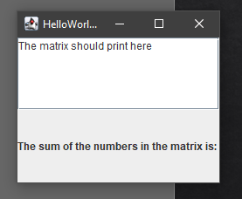
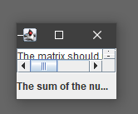
Step 4
You should run lab 11 as is
Notice that your window will not fit everything, remove the comment on frame.pack() and notice that the window will resize to fit the content

Slide 6
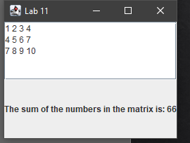
Step 5
You need to fill in the readAndDisplayMatrix.
The method should print out the matrix in the TextArea which is passed in the method as myText
It should also calculate the sum and set the text jLabel of the frame passed as myLabel in the method to display the calculated value (Go through the matrix with a nested loop)
You should also change the title to Lab 11
The syntax you will need it frameName.setTitle(“”), textAreaName.setText(“”), labelName.setText(“”).
You should add frameName.pack() so the popup adjusts to fit all the new content

